Slide 1
Social Distance Tracker
As the world enters a new phase of combating the COVID-19 pandemic, new reforms are coming into existence. The goal of this tracker is to make social distancing a practice and streamline overcrowding.

Slide 2
Introduction
Social distancing is a regulation initiated during the pandemic era and hence this tracker implements the guidelines which are to be followed by everyone.
Streamlines overcrowding

Slide 3
Background
I have created a model that is a necessity during the pandemic time. Social distancing is the upmost priority at the moment and to streamline overcrowding is the goal we have to achieve. We saw lack of resources during Covid-19 and the rush in grocery stores to purchase stocks in large quantities and hence the social distancing norm goes unfollowed.

Slide 4
Software and Hardware Requirement Specification
User Interface : Autodesk Tinkercad
Programming Language : C++
Cloud : ThingsSpeak
IDE Tool : TinkerCad

Slide 5
Key Elements
Automates Queues
1
Maintains Social Distancing
II
Streamlines Overcrowding
III

Slide 6
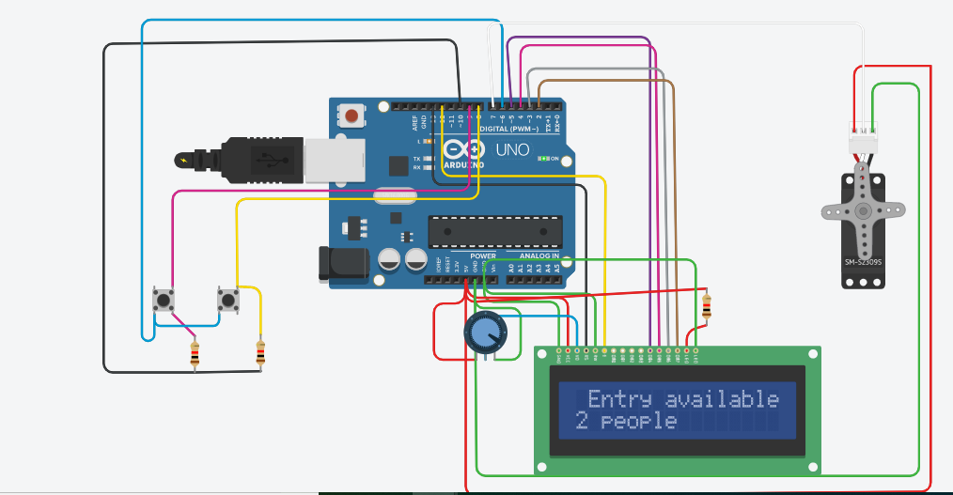
Working OF THE PROTOTYPE
On press of the push button entry is allowed to one person at a time depending on the availability of your slot and the desired number of people set by the grocery storemen. As you exit the store, one slot availability is automatically generated.

Slide 7
Future scope
1
Can determine rush in stores using IOT with cloud computing
II
III
Can store data over cloud for further analysis of business.
Can streamline process at various amusement parks, concerts etc

Slide 8
Thank You

